Slide 1
Networking for Software Developers
Lecture 3 – Summer 2024

Slide 2
Agenda
Python Advanced Concepts
Python Multithreading

Slide 3
Python Advanced Concepts

Slide 4
List Comprehension
Brackets containing an expression that is executed for each element within a For loop (with a conditional test)
Provides a short and concise way to create a new list based on existing an iterable object

Slide 5
List Comprehension
General syntax:
new_list = []
for <<item>> in <<iterable>>
if <<condition>>:
<<expression>>
new_list.append(<<item>>)

Slide 6
List Comprehension
List comprehension syntax – Basic:
new_list = [<<expression>> for <<item>> in <<iterable>>]

Slide 7
List Comprehension
List comprehension syntax – Advanced:
new_list = [<<expression>> for <<item>> in <<iterable>> <<condition>>]

Slide 8
List Comprehension
Example:
new_list = []
for num in range(20)
if num % 2 == 0:
new_list.append(num)

Slide 9
List Comprehension
Output:
print(new_list)
[0, 2, 4, 6, 8, 10, 12, 14, 16, 18]

Slide 10
List Comprehension
Example Continued:
new_list = [num for num in range(20) if x % 2 == 0]

Slide 11
List Comprehension
Output:
print(new_list)
[0, 2, 4, 6, 8, 10, 12, 14, 16, 18]

Slide 12
List Comprehension
Example:
new_list = [num * 5 for num in range(6, 13) if x % 3 != 0]

Slide 13
List Comprehension
Output:
print(new_list)
[25, 35, 40, 50, 55]

Slide 14
List Comprehension
Example:
matrix = [[1, 2, 3, 4], [4, 5, 6, 8]]
transposed = []
for index in range(len(matrix[0])):
transposed_row = []
for row in matrix:
transposed_row.append(row[index])
transposed.append(transposed_row)

Slide 15
List Comprehension
Output:
print(transposed)
[[1, 4], [2, 5], [3, 6], [4, 8]]

Slide 16
List Comprehension
Example:
matrix = [[1, 2, 3, 4], [4, 5, 6, 8]]
transposed = [[row[i] for row in matrix] for i in range(len(matrix[0]))]

Slide 17
List Comprehension
Output:
print(transposed)
[[1, 4], [2, 5], [3, 6], [4, 8]]

Slide 18
Set & Dictionary Comprehension
Brackets containing an expression that is executed for each element within a For loop (with a conditional test)
Provides a short and concise way to create a new set or dictionary based on existing an iterable object

Slide 19
Set & Dictionary Comprehension
Set comprehension syntax:
new_set = {<<expression>> for <<item>> in <<iterable>> <<condition>>}

Slide 20
Set & Dictionary Comprehension
Dictionary comprehension syntax:
new_dict = {<<expression>> for <<item>> in <<iterable>> <<condition>>}

Slide 21
Map, Filter and Reduce
Built-in functions to facilitate a functional approach to programming
Implement more elegant and short-hand approach to some problems without explicitly implementing loop and branching logic
Functional programming paradigms include:
Map() – operation that applies a specified function for each item in an iterable object
Filter() – operation that selects items from an iterable object based on the output of a specified function
Reduce() – operation that returns a single value based on an iterable object and a specified function

Slide 22
Map, Filter and Reduce
General syntax:
<<variable_name>> = map(<<function_name>>, <<iterable>>)
<<variable_name>> = filter(<<function_name>>, <<iterable>>)
from functools import reduce
<<variable_name>> = reduce(<<function_name>>, <<iterable>>)

Slide 23
Note on Lambda Function
Utilized to develop small anonymous function with:
Any number of arguments
Only have one expression
Lamba Syntax:
lambda <<arguments>>: <<expression>>
<<variable_name>> = lambda <<arguments>>: <<expression>>

Slide 24
Note on Lambda Function
Example:
input_1 = int(input('Enter number value #1: '))
input_2 = int(input('Enter number value #2: '))
x = lambda a, b: a * b
print(x(input_1,input_2))

Slide 25
Map, Filter and Reduce
Example:
def to_fahrenheit(c):
return 9 / 5 * c + 32
def to_celsius(f):
return (f - 32) * 5 / 9

Slide 26
Map, Filter and Reduce
Example Continued:
cels_temps = [100, 40, 80]
converted_fahr_temps = map(to_fahrenheit, cels_temps)
converted_fahr_temps = list(converted_fahr_temps)
fahr_temps = [212, 104, 176]
converted_cels_temps = map(to_celsius, fahr_temps)
converted_cels_temps = list(converted_cels_temps)

Slide 27
Map, Filter and Reduce
Output:
print(converted_fahr_temps)
[212.0, 104.0, 176.0]
print(converted_cels_temps)
[100.0, 40.0, 80.0]

Slide 28
Map, Filter and Reduce
Example Continued:
cels_temps = [100, 40, 80]
converted_fahr_temps = list(map(lambda c: 9 / 5 * c + 32, cels_temps))
fahr_temps = [212, 104, 176]
converted_cels_temps = list(map(lambda f: (f - 32) * 5 / 9, fahr_temps))

Slide 29
Map, Filter and Reduce
Output:
print(converted_fahr_temps)
[212.0, 104.0, 176.0]
print(converted_cels_temps)
[100.0, 40.0, 80.0]

Slide 30
Map, Filter and Reduce
Example:
def question_mark_finder(word):
if word.find('?') != -1:
return True
else:
return False

Slide 31
Map, Filter and Reduce
Example Continued:
text = [["You've", 'gotta', 'ask', 'yourself', 'a', 'question'], ['do', 'I', 'feel', 'lucky?', '…well'], ['do', 'ya', 'punk?']]
filtered = filter(question_mark_finder, [word for sublist in text for word in sublist])
print(list(filtered))

Slide 32
Map, Filter and Reduce
Output:
print(list(filtered))
['lucky?', 'punk?']

Slide 33
Python Multithreading

Slide 34
Multithreading
Process – instance of a computer application with three components:
Executable program
Associated data required (variables, workspace, buffers, etc.)
Execution context (i.e., State of process)
Thread – entity within a process (executed by a scheduler)
Smallest unit of processing (i.e., sequence of instructions that can be independently executed) performed at the OS level

Slide 35
Multithreading
Multithreading - ability of a processor to execute multiple threads concurrently
Note: Concurrency allows multiple tasks to execute one at a time in an interleaving manner
Only one thread can be executed at a time due to Python GIL
Useful for IO-bound processes (e.g., reading and writing files from a network or database)
Multiprocessing - ability of a system to run multiple processors in parallel
Note: Parallelism allows multiple tasks to execute simultaneously
Useful for CPU-bound processes (e.g., computationally heavy tasks)

Slide 36
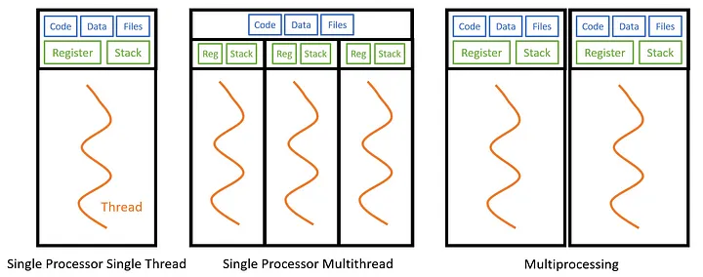
Multithreading

Slide 37
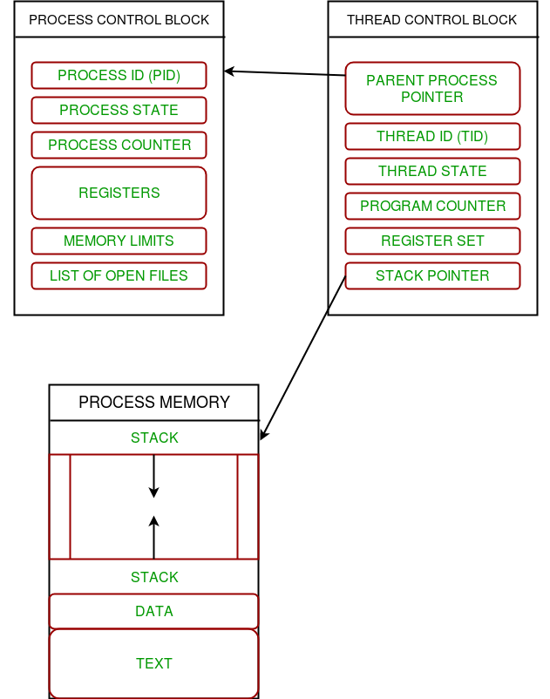
Multithreading
Multiple threads can exist within one process
Within one process, threads share memory and the state of the process
Each thread contains an independent register set and local variables (stored in stack)
All threads of a process share global variables (stored in heap) and code

Slide 38
Multithreading
Thread states include the following:
New thread – Thread is not initiated and not allocated any resources
Runnable –Thread is waiting to run based on the direction of the scheduler and has the required resources
Running – Thread with a stream of executing instructions and can lead to a non-running state or die
Not-running – Thread is paused due to another thread taking precedence or the thread is waiting for a long-running IO operation
Dead – Thread has terminated due to it has reached the natural end of its stream of execution or the thread has been killed

Slide 39
Multithreading
Example:
import threading, time
def sleeper(t, name):
print(f'{name} going to sleep for {t}s')
time.sleep(t)
print(f'{name} has awoken from sleep')

Slide 40
Multithreading
Example Continued:
t = threading.Thread(
target = sleeper, #callable object
name = 'thread1', #thread name
args = (5, 'thread1') #arguments as a tuple
)

Slide 41
Multithreading
Example Continued:
t2 = threading.Thread(
target = sleeper, #callable object
name = 'thread2', #thread name
args = (4.5, 'thread2') #arguments as a tuple
)

Slide 42
Multithreading
Example Continued:
t.start() #starts the thread execution
t2.start()
print(f'{threading.active_count()} active threads')
t.join() #wait until thread is completed
t2.join()
print('program has terminated')

Slide 43
Multithreading
Output:
thread1 going to sleep for 5 seconds
thread2 going to sleep for 4.5 seconds
2 active threads
thread2 has woken from sleep
thread1 has woken from sleep
program has terminated.

Slide 44
Multithreading
Example – Multiple Threads:
import threading, logging, time
def thread_function(name):
logging.info("Thread %s: starting", name)
time.sleep(2)
logging.info("Thread %s: finishing", name)

Slide 45
Multithreading
Example – Multiple Threads Continued:
if __name__ == "__main__":
format = "%(asctime)s: %(message)s"
logging.basicConfig(format=format, level=logging.INFO,
datefmt="%H:%M:%S")

Slide 46
Multithreading
Example – Multiple Threads Continued:
threads = list()
for index in range(3):
logging.info("Main : create and start thread %d.", index)
x = threading.Thread(target=thread_function, args=(index,))
threads.append(x)
x.start()

Slide 47
Multithreading
Example – Multiple Threads Continued:
for index, thread in enumerate(threads):
logging.info("Main : before joining thread %d.", index)
thread.join()
logging.info("Main : thread %d done", index)

Slide 48
Multithreading
Output:
Main : create and start thread 0.
Thread 0: starting
Main : create and start thread 1.
Thread 1: starting
Main : create and start thread 2.
Thread 2: starting
Main : before joining thread 0.

Slide 49
Multithreading
Output:
Thread 2: finishing
Thread 1: finishing
Thread 0: finishing
Main : thread 0 done
Main : before joining thread 1.
Main : thread 1 done
Main : before joining thread 2.
Main : thread 2 done

Slide 50
Multithreading
Example – Multiple Threads:
import concurrent.futures
def thread_function(name):
logging.info("Thread %s: starting", name)
time.sleep(2)
logging.info("Thread %s: finishing", name)

Slide 51
Multithreading
Example – Multiple Threads Continued:
if __name__ == "__main__":
format = "%(asctime)s: %(message)s"
logging.basicConfig(format=format, level=logging.INFO,
datefmt="%H:%M:%S")
with concurrent.futures.ThreadPoolExecutor(max_workers=3) as executor:
executor.map(thread_function, range(3))

Slide 52
Multithreading
Output:
Thread 0: starting
Thread 1: starting
Thread 2: starting
Thread 1: finishing
Thread 0: finishing
Thread 2: finishing

Slide 53
Multithreading
Related Concepts:
Context Switching
Race Conditions
Deadlocks
Starvation
Livelock

